Slide 1


Object Oriented Programming
Introduction to Java
ILIA STATE UNIVERSITY
Paata Gogishvili
Doctor of Informatics
Associate Professor
School of Technology
March 01, 2024
Faculty of Business, Technology and Education

Slide 2
Lecture Topics
Introduction to OOP
About Java
JVM, JRE, JDK
Java syntax.
ILIA STATE UNIVERSITY

Slide 3
Brief history
Java's history dates to the early 1990s when it was developed by a team led by James Gosling at Sun Microsystems. The project was originally called "Oak" after an oak tree that stood outside Gosling's office. It was later renamed "Java," inspired by Java coffee, a type of coffee from Indonesia.
Java is now owned by Oracle Corporation. It is known for its "write once, run anywhere" (WORA) capability, meaning that Java code can be written on one platform and run on any platform that has the Java Virtual Machine (JVM) installed. This makes Java a highly portable language.
ILIA STATE UNIVERSITY

Slide 4
Brief history
Java syntax is like C++, but it eliminates certain low-level constructs like pointers, which can make the language easier to learn and use. Java applications are typically compiled to bytecode, which is executed by the JVM, ensuring platform independence.
Java is widely used in various domains, including web development, mobile app development (especially Android apps), desktop applications, and large-scale enterprise systems.
It has a large and active community, providing a vast array of libraries and frameworks that simplify development in many areas.
ILIA STATE UNIVERSITY

Slide 5
Structure of Java
In the world of Java programming, three key components play crucial roles in the development and execution of Java applications: the Java Virtual Machine (JVM), the Java Runtime Environment (JRE), and the Java Development Kit (JDK). Understanding the differences and relationships between these components is essential for any Java developer.
ILIA STATE UNIVERSITY

Slide 6
Java Virtual Machine (JVM)
The JVM is the heart of the Java programming language. It is an abstract computing machine that enables a computer to run Java programs as well as programs written in other languages that are also compiled to Java bytecode. The JVM is responsible for executing the bytecode and providing the runtime environment necessary for Java applications. It is platform-independent, meaning that the same Java code can run on any operating system that has a compatible JVM.
ILIA STATE UNIVERSITY

Slide 7
Java Runtime Environment (JRE)
The JRE is a software package that provides the runtime environment for executing Java applications. It includes the JVM, core libraries, and other components necessary for running Java programs. The JRE is platform-specific, as it needs to interface with the underlying operating system. When you run a Java application, you are essentially running it on the JRE.
ILIA STATE UNIVERSITY

Slide 8
Java Development Kit (JDK)
The JDK is a full-featured software development kit for Java developers. It includes the JRE, as well as a set of development tools such as a compiler (javac), debugger, and documentation generator. The JDK allows developers to compile Java source code into bytecode, which can then be executed by the JVM. The JDK is essential for developing Java applications, as it provides all the necessary tools and libraries.
ILIA STATE UNIVERSITY

Slide 9
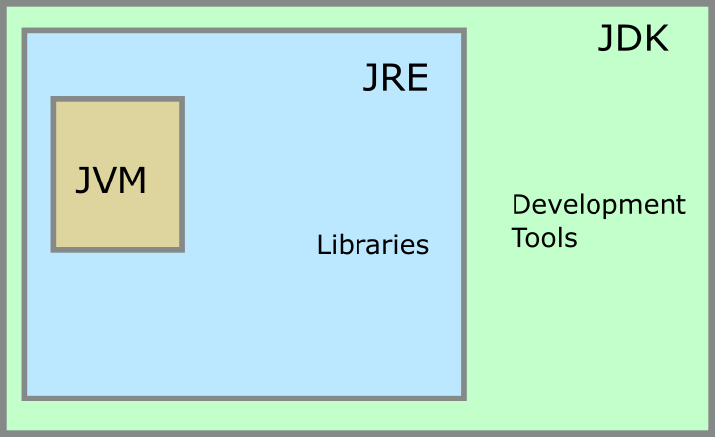
JDK-JRE-JVM
ILIA STATE UNIVERSITY

Slide 10
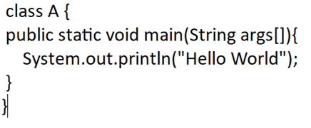
“Hello World” program in Java
ILIA STATE UNIVERSITY

